Slide 1
Building an app for Microsoft Teams which creates conversational tabs and conversations based on external events
Eoin O’Brien

Slide 2
Agenda
Conversational Tabs
Creating conversations from bots
Our proof of concept
Demo
Code walk through

Slide 3
Building Blocks
Notes:
That’s a mouthful of a title so I apologise for that. But we wanted to showcase a scenario that while possible today might not be immediately obvious from the documentation and samples.
But before I run through our new sample, let me quickly summarise some key building blocks

Slide 4
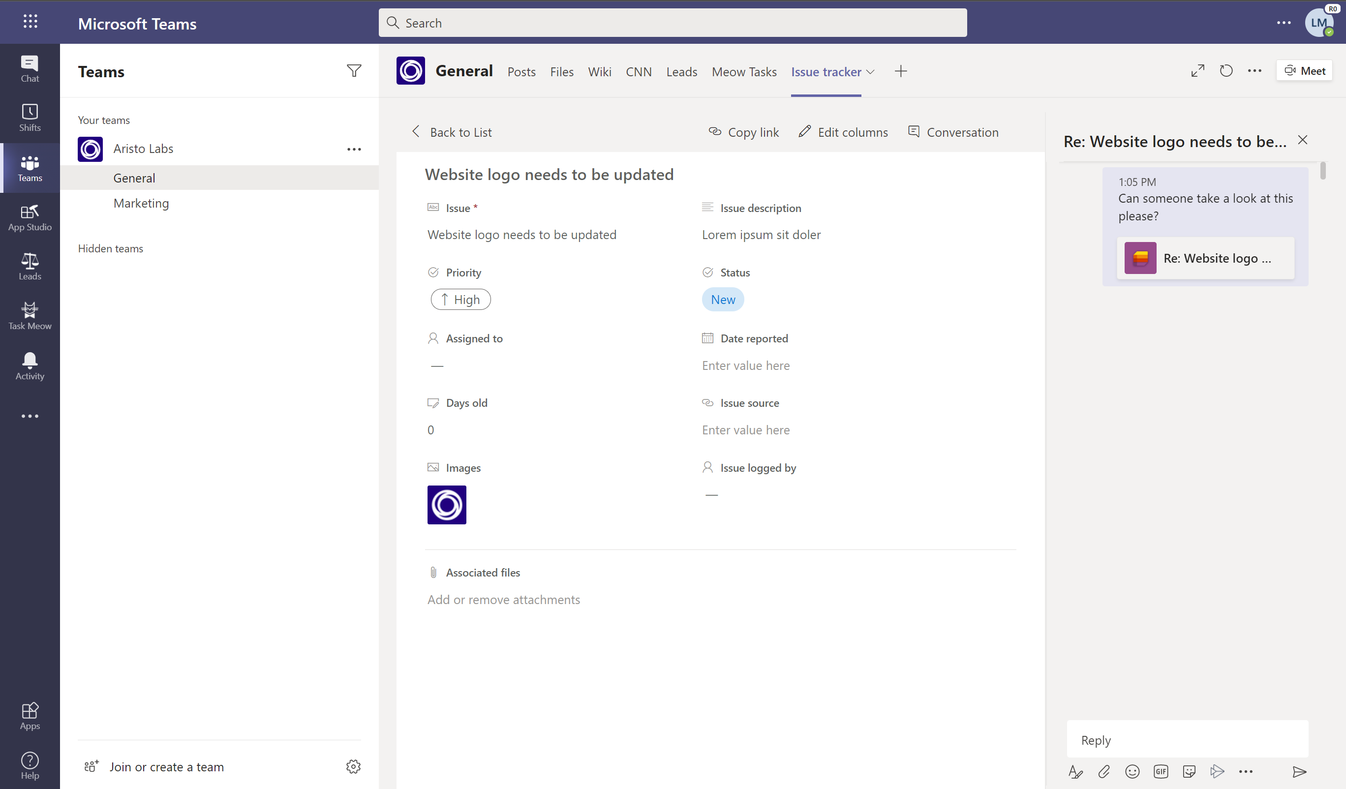
Conversational Tabs
Conversation around a sub page/entity in a tab
Channel conversation
Teams JS SDK
microsoftTeams.conversations.openConversation({
"subEntityId": "task-1",
"entityId": "tabInstanceId-1",
"channelId": "19:baa6…2baa8e5a@thread.skype",
"title": "Re: Website logo needs to be…"
});
https://docs.microsoft.com/en-gb/microsoftteams/platform/tabs/how-to/conversational-tabs
Notes:
Allows for a conversation around a sub page or sub entity.
The conversation will be visible in the channel the tab is installed in.
It uses the Teams JS SDK to handle the connection into the teams client.
It’s not something that has been used super popularly, I would argue because it provides little value to ISVs beyond allowing the customers to chat. There ISV kinda fires and forgets that the conversation has started.

Slide 5
Conversational Tabs
Conversation around a sub page/entity in a tab
Channel conversation
Teams JS SDK
microsoftTeams.conversations.openConversation({
"subEntityId": "task-1",
"entityId": "tabInstanceId-1",
"channelId": "19:baa6…2baa8e5a@thread.skype",
"title": "Re: Website logo needs to be…",
"conversationId": "19:aebd0ad4d6ab42c8b9ed19c257…"
});
https://docs.microsoft.com/en-gb/microsoftteams/platform/tabs/how-to/conversational-tabs
Notes:
But one very useful feature is that you can pass in a conversationId to the openConversation call.
This allows you to reopen a conversation about an entity if you want to in the future.
This is something you have to store yourself, but that will be useful when we come to the POC.

Slide 6
Bots in Teams
Creating and responding to conversations
Activity handlers
Send text, cards, images, emoji
Focused on responding to events rather than creating them
https://docs.microsoft.com/en-gb/microsoftteams/platform/bots/how-to/conversations/conversation-messages

Slide 7
Bots: Creating Conversations
Built on Bot Framework
Create conversations directly using the ConnectorClient
Requires a ServiceUrl
https://docs.microsoft.com/en-us/dotnet/api/microsoft.bot.connector.conversationsextensions.createconversationasync

Slide 8
Proof of Concept

Slide 9
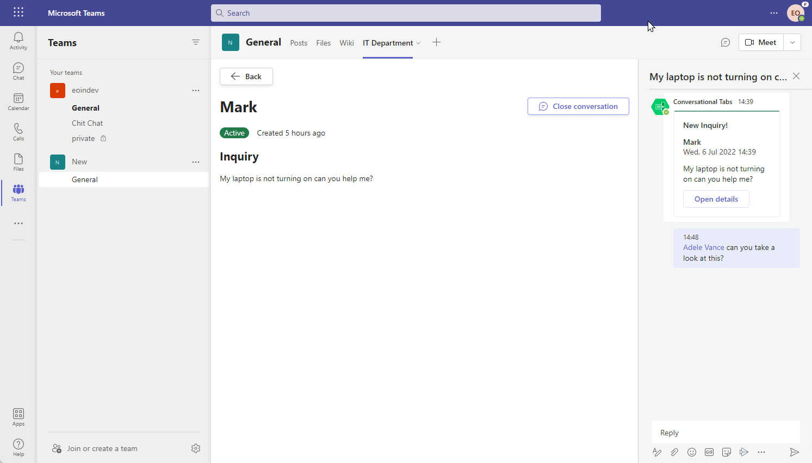
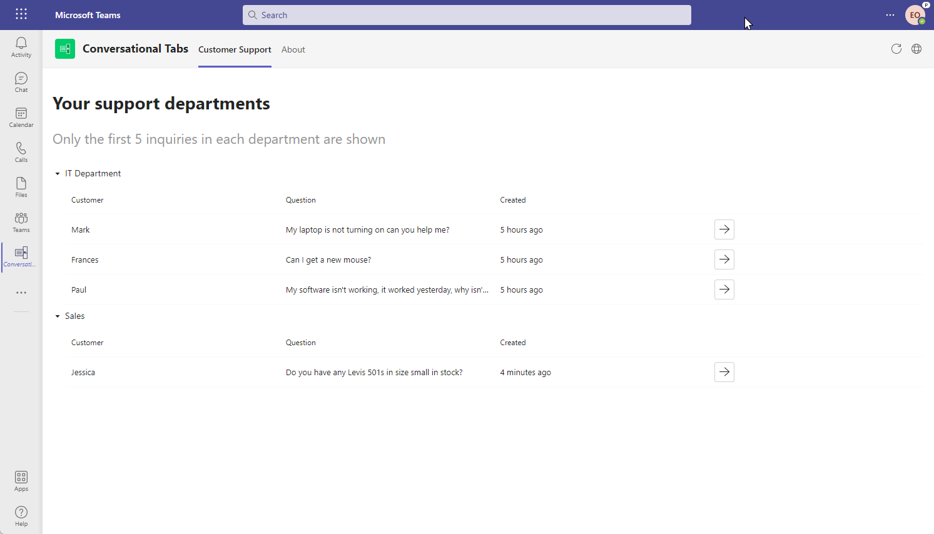
Proof of Concept Scenario
Conversation about an external event
Include context in a tab
Omnichannel support
Job applications
Incident Management
Notes:
Conversation about an external event
Include context in a tab
Omnichannel support
Conversation about a support ticket in the sidebar with ticket details in a tab
Job applications
Conversation on a candidate, with application visible in a tab
Incident Management
Conversation for an incident in the sidebar, and view more details in a tab

Slide 10
Proof of Concept from the Building Blocks
Get Service URL from bot install activity
Create a conversation using a Bot Client
Send conversationId to tab to be used in conversational tabs
Open conversation in Tab side panel

Slide 11
Demo
Notes:
“I’ve installed the app already, but there is nothing to special about that”
Showcase Echo bot
Go to external app
“This is a stand in for a support chat, which it obviously isn’t. But essentially is the “External” in this example, this could be replaced with an actual support chat or an application for a job.”
Show conversation in channel
Open deeplink
Reply to conversation in side panel
Go back to channel
Open tab from top bar
Explain how this works
Go to personal app
“And here is a great feature of the conversational tabs. I have created a personal app listing all the support departments I am a member of, based on channel membership. Here I can open a ticket, and view and reply to the conversation about that directly. And if I go back to the team you can see it end up there”

Slide 12
Support request from customer
API Endpoint
Teams Client
Create conversation for request
View conversation in channel
Add request to DB
Sub-entity with conversation
Notes:
So here is a simple workflow of the proof of concept.
On the left you can see a support request coming in from a customer. This might be via a chat function on a website or maybe a CRM software.
This calls an API endpoint, here information about the request is stored in a database and a new conversation is created in a channel.
Then in the Teams Client someone can either see the conversation in the channel, or you can view the sub-entity in the tab with the conversation in the side bar.

Slide 13
Code Walkthrough
https://github.com/OfficeDev/Microsoft-Teams-Samples/tree/main/samples/bot-tab-conversations/csharp
Notes:
Code will be in main very shortly but until then you can find it at the above address.

Slide 14
Questions
Code available at:
https://github.com/OfficeDev/Microsoft-Teams-Samples/tree/main/samples/bot-tab-conversations/csharp

